Slide 1
THE SAFE ARK
AUTO TRADING PLATFORM
A

Slide 2
Earn While You Learn With RVA

Slide 3
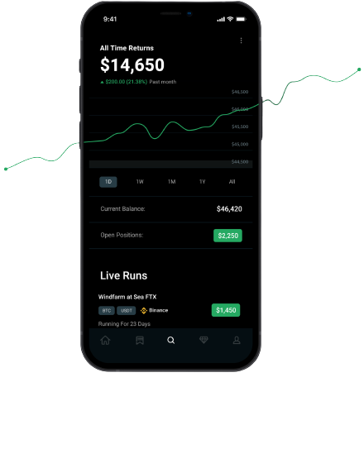
THE SAFE ARK
WHO ARE WE?
A group of professional traders who have failed forward to success over a combined training and trading period of over 20 years.
Now with much experience on what works and is generating results we now bring to public one of our core success factors THE SAFE ARK an AI System which is an Automated Trading Service

Slide 4
The Safe Ark Key Features
Automated Trading
Register and Set Up an Account in a dynamic platform
Hands Free Real-time Market Analysis/EA enhanced
Multi-Level Marketing Reward Structure:
Top Risk Management Practice

Slide 5
WHAT IS ACTUALLY BEING TRADED
FOREX
At its simplest, A trader buys one currency and sells another, and the exchange rate constantly fluctuates based on supply and demand.
Currencies are traded in the foreign exchange market, a global marketplace that’s open 24 hours a day Monday through Friday. All forex trading is conducted over the counter (OTC), meaning there’s no physical exchange (as there is for stocks) and a global network of banks and other financial institutions oversee the market (instead of a central exchange, like the New York Stock Exchange).

Slide 6
Active Trades Passive Income
Effortless portfolio building AI trading tool
SafeARK AI automates trading experience for rookie and expert traders looking to create pro fit from the market.
Our trading system leverages Expert Advisor (EA) technology, enhancing precision and efficiency in executing trades for optimal results.
Manage trading risk by integrating SafeARK in your trading platform

Slide 7
THE SAFE ARK SUBSCRIPTION
Partners are required to make a one-time annual subscription to become a part of The Safe Ark community. This subscription grants them exclusive access to automatically copy the company’s advanced trading bot, which is equipped with the capability to yield returns ranging from 1% to 10% monthly.

Slide 8
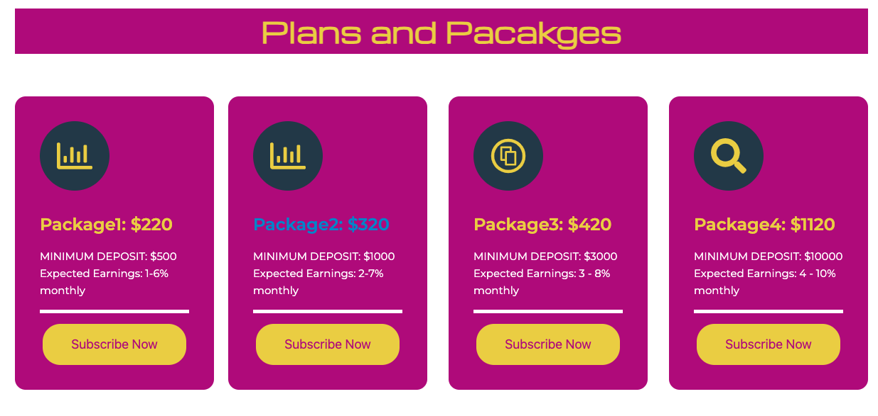

Slide 9
WHY CHOOSE SAFE ARK
AUTOMATED TRADES
DECENTRALISED SYSTEM
100% CONTROL OF YOUR ACCOUNT
EASY DEPOSIT AND WITHDRAWAL AT ANY TIME
TRANSPERENT
LOW RISK AND ACCOUNT PROTECTION

Slide 10
Register and Set Up an Account
You will open your own trading account with any broker of your choice and fund the account with minimum of $500
Register on The Safe Ark platform and connect your trading account to our Strategic Trading Account
The Safe Ark algorithym trades our Strategic Trading Account and your own trading account replicates (mirrors) the trading activities on our Strategic Trading Account
The Profit and Loss in our account is also reflected in your own account in the same ratio

Slide 11
Register and Set Up an Account
You will open your own trading account with any broker of your choice and fund the account with minimum of $500
Register on The Safe Ark platform and connect your trading account to our Strategic Trading Account
The Safe Ark algorithym trades our Strategic Trading Account and your own trading account replicates (mirrors) the trading activities on our Strategic Trading Account
The Profit and Loss in our account is also reflected in your own account in the same ratio

Slide 12
THE BIGGER PICTURE TO GROW
Partners are required to make a one-time annual subscription to become a part of The Safe Ark community. This subscription grants them exclusive access to automatically copy the company’s advanced trading bot, which is equipped with the capability to yield returns ranging from 1% to 10% monthly.

Slide 13
Think Big……

Slide 14
THE SAFE ARK PARTNERS COMPENSATION PLAN

Slide 15
3 LEVELS UNILEVEL COMPENSATION PLAN

Slide 16
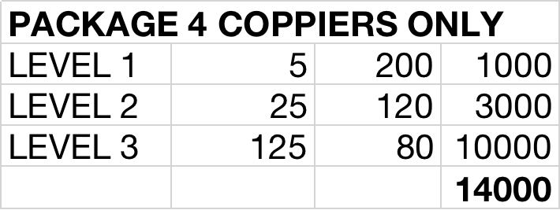
EXAMPLE USING PACKAGE 4 ONLY
NB: Note that there is no restriction to the number of persons you can register directly

Slide 17
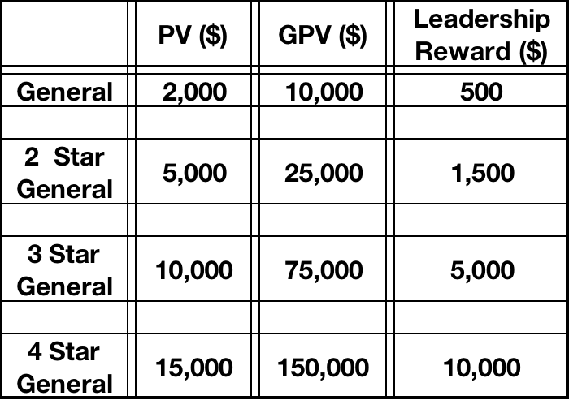
LEADERSHIP RANKINGS AND AWARDS

Slide 18
LEADERSHIP RANKINGS AND AWARDS
NOTE THAT THE AWARD ONCE ATTAINED IS PAID OUT YEARLY,
AS LONG AS THE VOLUME IS MAINTAINED
GPV IS CONSIDERED ON VOLUME GENERATED BETWEEN LEVELS 1 - 3 THE GENEOLOGY
YEAR 1 AWARD IS STRICTLY CASH AWARDS WHILE SUBSEQUENT YEARS COULD BE IN FORM OF INCENTIVE/CASH
BASED ON LEADERS PERFORMANCE ABOVE THE STATED RANKINGS OUTSTANDING LEADERS ARE OFFERED SHAREHOLDINGS IN THE ORGANISATION

Slide 19
HOW TO GET STARTED
You will open your own trading account with any broker of your choice and fund the account with minimum of $500
Get a refferal link from your inviter
Register on The Safe Ark platform based on the package you want to trade with.
Connect your account to the Safe Ark Strategic Trading Account
Watch your account grow

Slide 20
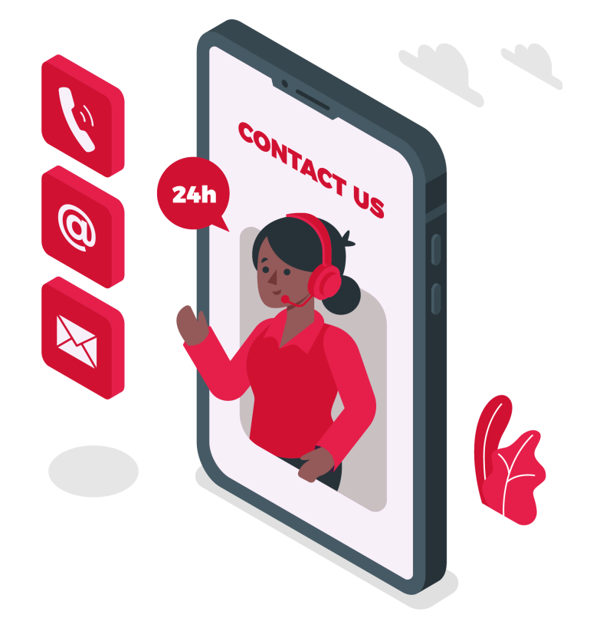
READY TO GET STARTED?
CONTACT THE PERSON THAT INTRODUCED YOU TO THIS OPPORTUNITY

Slide 21
THANK YOU

